Slide 1
Supervised Learning capstone presentation
Kristin Kusheva
July, 2019

Slide 2
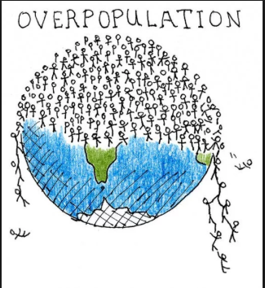
Overview
In November 2011, the global human population passed a significant milestone, reaching seven billion people. By the year 2050, the Population Division of the United Nations (2011) predicts that the planet will support more than nine billion people.
According to the Food and Agriculture Organization of the United Nations (FAO) (2013a), demand for food, fuel, and fiber will thus increase 60% by the year 2050.
The global population is predicted to face a growing food crisis during the next century. Worldwide, one in seven people have insufficient energy and protein within their diet to maintain health and well-being (Godfray et al. 2010)
Principal concerns relating to food sustainability in developing regions currently focus on limited food availability due, at the farm-level, to low agricultural yields, lack of producer education, and inadequacies of transport and sanitary infrastructure (Godfray et al. 2010).

Slide 3
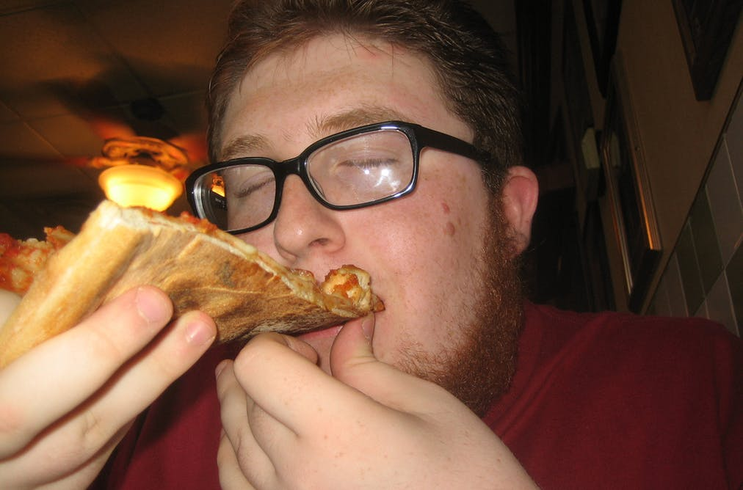
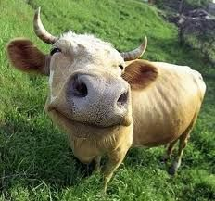
Food vs. feed
The solutions to fight with the upcoming crisis include changing the way we grow our food and changing the way we eat. To make things harder, the world's climate is changing and it is both affecting and affected by the way we grow our food – agriculture.
Food VS Feed - feed refers to food given to cattle or other animals.

Slide 4
The Dataset
‘The Food and Agriculture Organization of the United Nations provides free access to food and agriculture data for over 245 countries and territories, from the year 1961 to the most recent update (depends on the dataset). One dataset from the FAO's database is the Food Balance Sheets. It presents a comprehensive picture of the pattern of a country's food supply during a specified reference period, the last time an update was loaded to the FAO database was in 2013. The food balance sheet shows for each food item the sources of supply and its utilization. This chunk of the dataset is focused on two utilizations of each food item available: Food and Feed’.

Slide 5
Our aim
1) Analyse the data
2) Construct a model that predicts the amount of food produced by a given country during the next 5 years
3) Create a classification model that categorise the food into the ‘food’ or ‘feed’ category

Slide 6
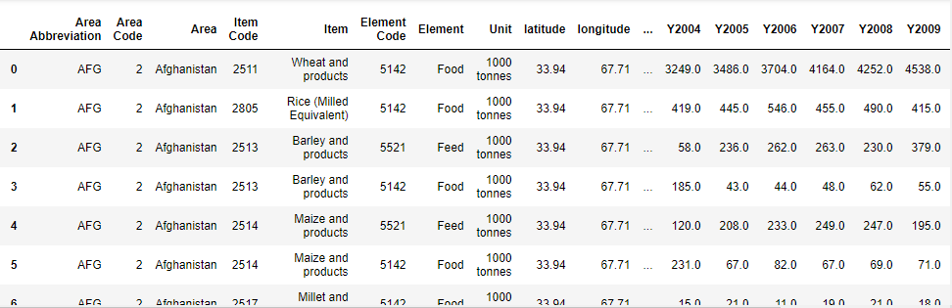
Snapshot of the dataset

Slide 7
Variables
Area Abbreviation-Country name abbreviation
Area Code-Country code
Area - Country name
Item Code - Food item code
Item - Food item
Element Code - Food or Feed code
Element - Food or Feed
Unit - Unit of measurement
Latitude - latitude
Longitude - longitude
Y1961
Y1962…. Y2013

Slide 8
Data cleaning and feature selection
Some of the variables are highly correlated with each other as they provide similar information so we will leave only those who will be relevant to our aim:
Area, Element and Item and all the time series columns (from Y1961 to Y2013)
No outliers are found in the data
The data is relatively complete – just a few countries that do not exist anymore, such as Czechoslovakia, were deleted from the database.

Slide 9
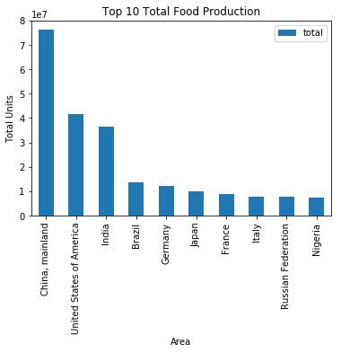
Aim 1): analysis
Top 10 total food producers:

Slide 10
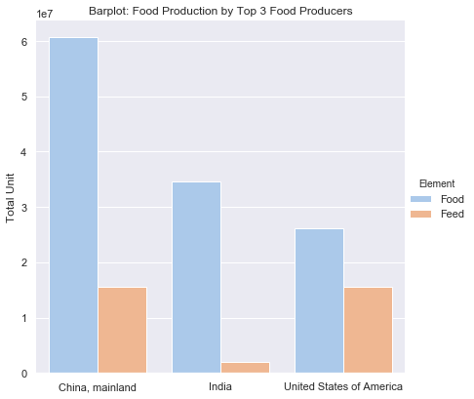

Slide 11
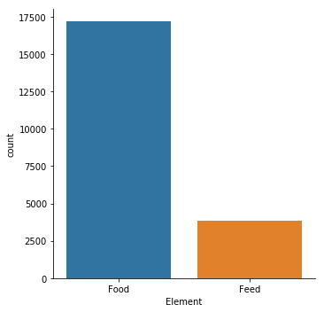
Total Food vs total feed production

Slide 12
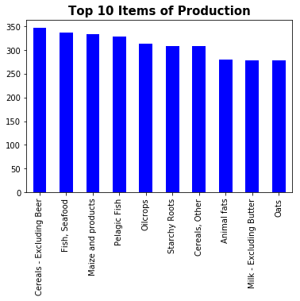
Top 10 items of production

Slide 13
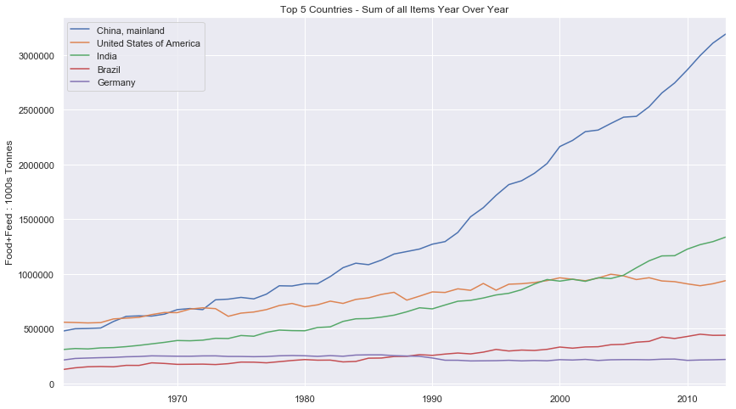
Food + Feed throughout the years (top 5 countries)
There is a possible correlation between the rise of the food production and the growing population in the countries. Thus, let’s visualise how is the food production is changing over the years in a country like Bulgaria, where the population is actually decreasing:

Slide 14
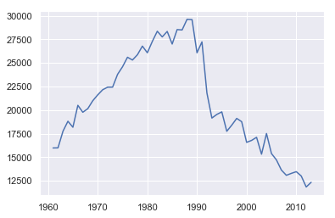
The food production in Bulgaria over the years in units:
A possible reason why we see the drop of the food production after 1990 might be the End of the Communist rule in 1989.

Slide 15

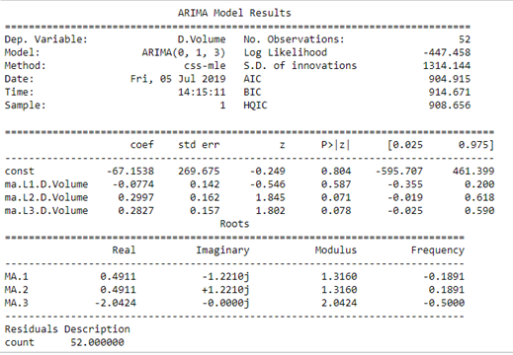
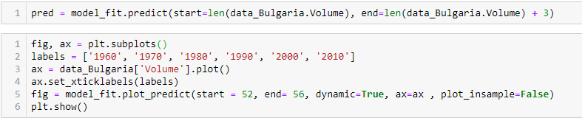
Aim 2): Modelling using arima

Slide 16
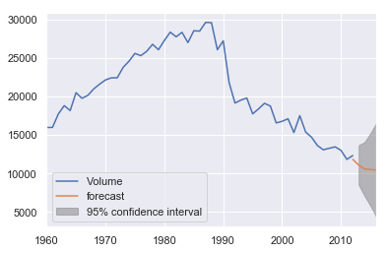
Modelling using arima cont.
Our Arima model predicts that during the next 3 years the total food production in Bulgaria will continue to decrease. This is what the predictions for its population show as well, so for further studies, it is highly recommended to look for a correlation between the population number and the food production in a given country.

Slide 17
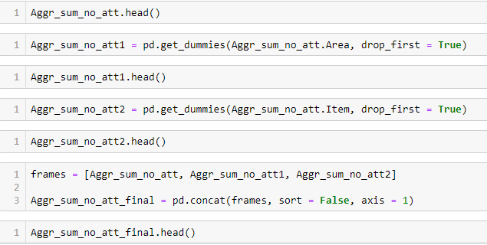
Aim 3): constructing a classification model
Using various classification algorithms, our aim is to predict if an Element is ‘Food’ or ‘Feed’ – a.k.a. if it is for humans or for animals.
First, we have to create dummy variables for categorical features and we will use the get_dummy function to turn them into numerical features.

Slide 18
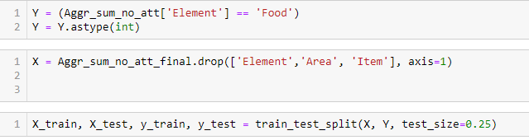
The next step is to define our features and our target variable(the one that we want to predict); of course we split them into train and test subsets:

Slide 19
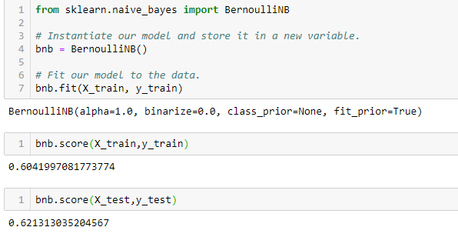
bernoulli Naive Bayes Classifier
Our model is not performing very well – it is just 62% accurate. Let’s try another algorithm.

Slide 20
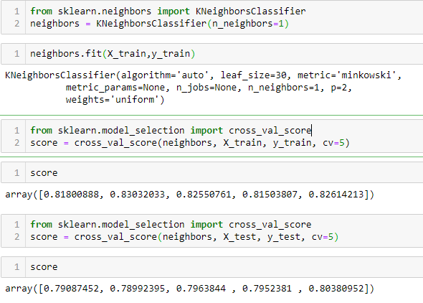
Knn classifier
This model performs much better with 80% accuracy. So far this is the best fit.

Slide 21
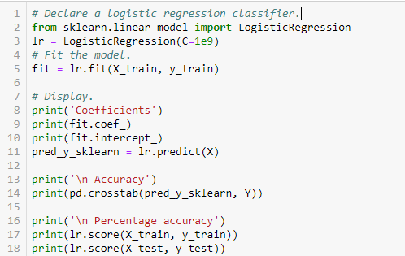
Logistic regression

Slide 22
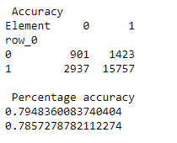

Logistic regression cont
This model shows less accuracy than the Kneighbors Classifier but it is more accurate than the Bermoulli one. Judging by the confusing matrix, it seems like the Type 2 error is twice as much as the Type 1 error. So the problem is that it classifies some of the Elements as ‘Food’ but they are actually ‘Feed’
To conclude, our best model is created when using the KNN classifier. So, hey, KNN:

Slide 23
The grande conclusion
Summarising the results:
- the model using KNN classifier shows the best accuracy rate– more than 80%; it is good for classifying the Items into either Food or Feed category.
- our Arima model shows that the total food production in Bulgaria will continue to decrease during the next 3 years.
What could that solution mean moving forward – further studies
- Why in some countries the food production rapidly increases, (China) in some it stays the same (Germany) and in some it declines? (Bulgaria); there is a possible link between the amount of food production and the population growth
- judging by the amount of food produced, we can identify if it is food or feed; what else could be a feature that helps identifying the item?

Slide 24

Thanks for watching ☺

